Slide 1
Trip to Bali
Summer Holiday Project
2020

Slide 2
Who?
A young couple
Budget = £2600
Going for 2 weeks

Slide 3
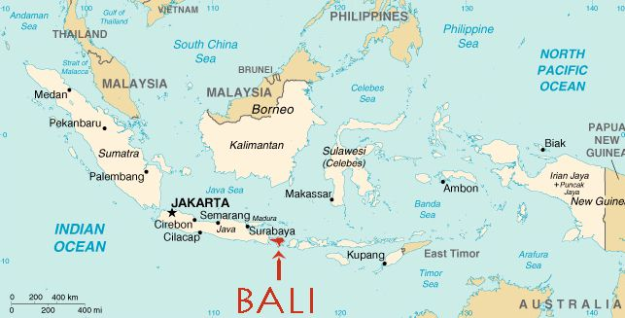
Where?
Bali, Indonesia
-An island located in the Indian Ocean
Flights- £700

Slide 4
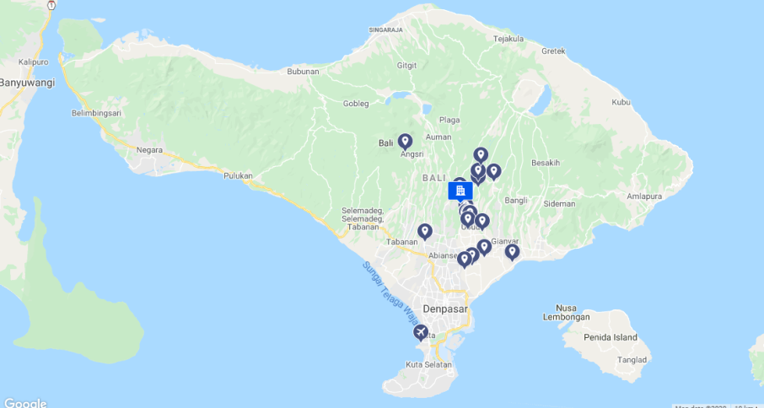
Accomodation
The Sankara Resort by Panama
Price- £1065 + £154 (breakfast)
Activities-
Pool
Spa
Bike Hire
Yoga classes
Restaurant/bar

Slide 5
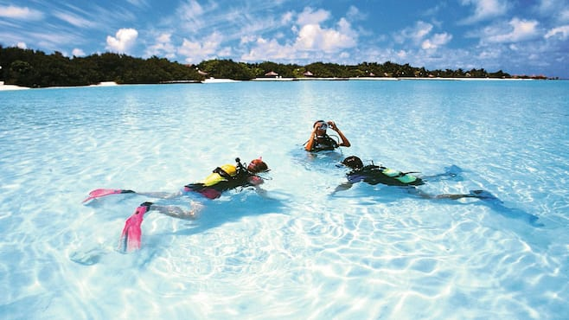
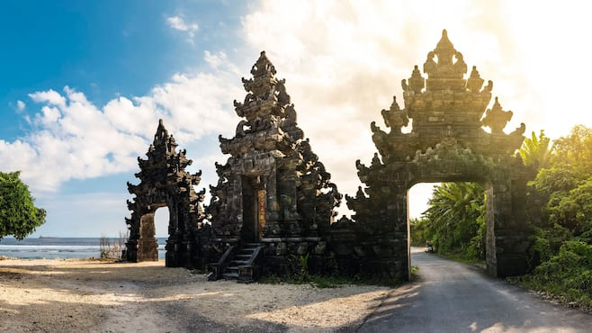
Final Price = £1919
This leaves £681 for the rest of the food and other activities such as…
Scuba Diving
Visiting the Uluwatu Temple
Have dinner overlooking the Tegalanglang Rice Terrace

