Slide 1
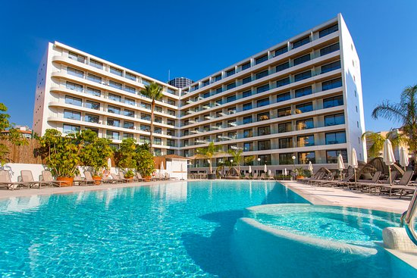
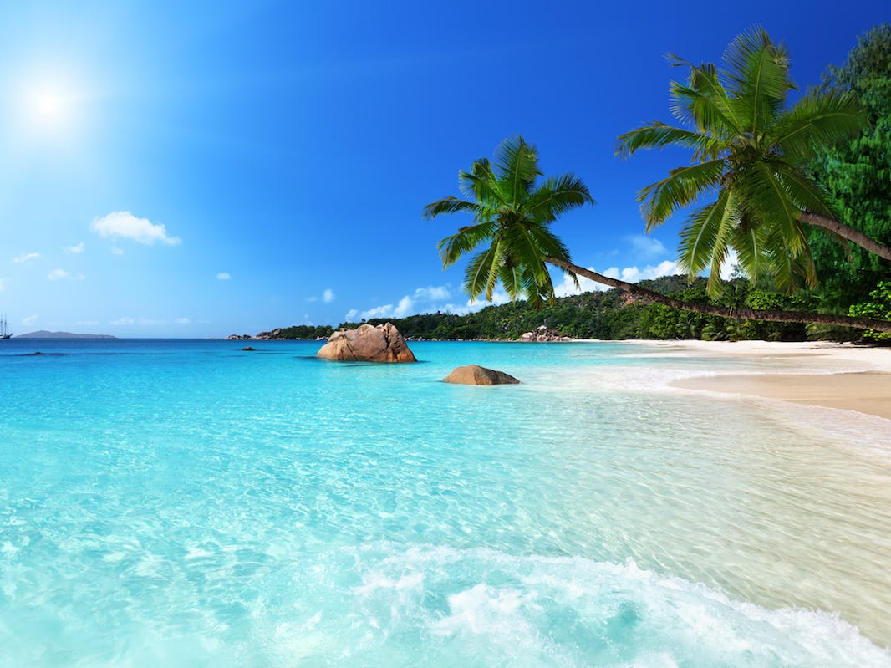
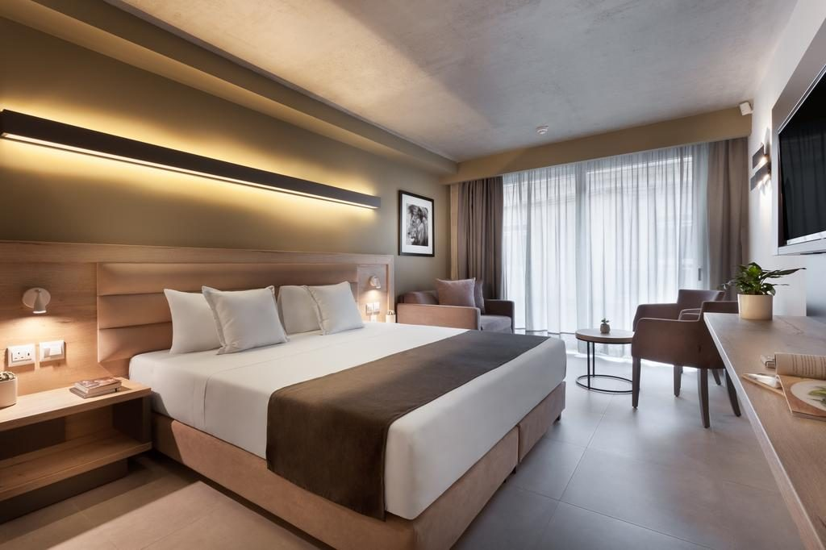
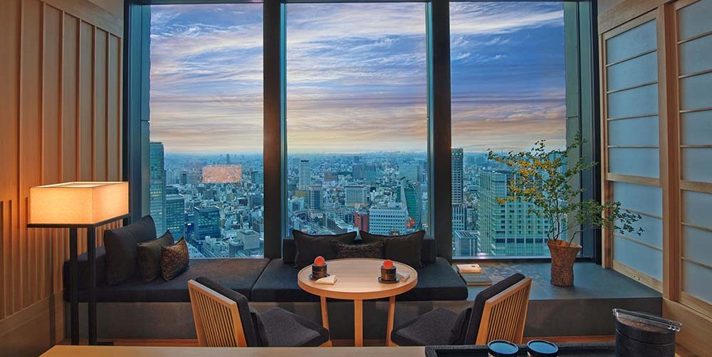
Holiday Presentation

Slide 2
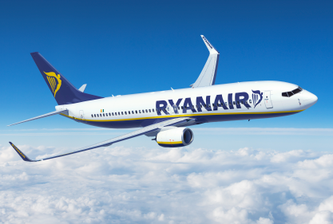
Flight
I have been given a budget of £3000 to book a holiday for 2 weeks for a variety of different travellers to be sent abroad.
I have decided to send a young couple to Lisbon, Portugal.
They are flying from Dublin (DUB) to Lisbon (LIS) and back= £166.
The duration of the flight is 2-3 hours.
They are flying in economy class with Ryanair.

Slide 3
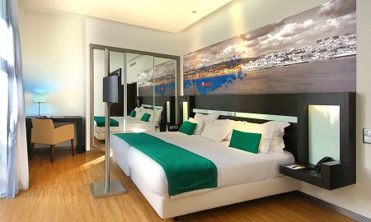
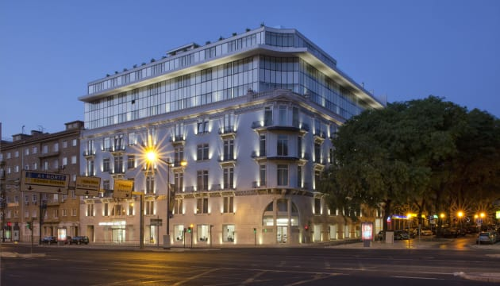
Accommodation
I have booked a stay from 13 July 2020-27 July 2020, 2 weeks long.
They are staying at the Jupiter Lisboa Hotel with a pool. They are staying in a standard double room for the full 2 weeks for £1165.
The hotel is located in the centre of Lisbon, and is perfect for 2 travellers.

Slide 4
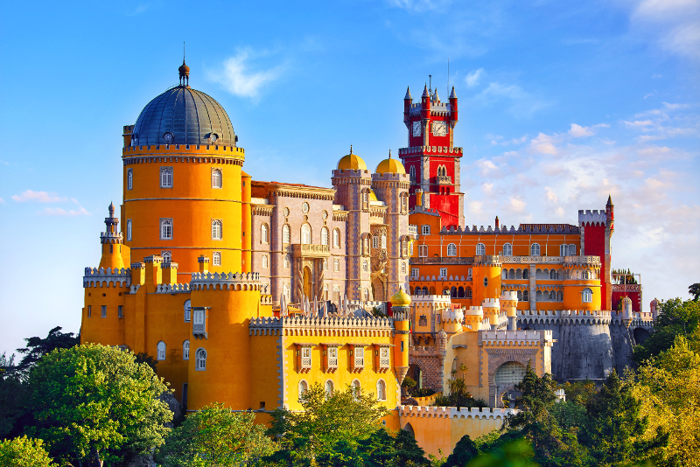
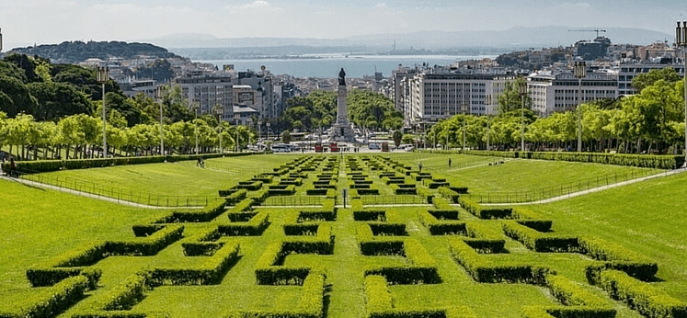
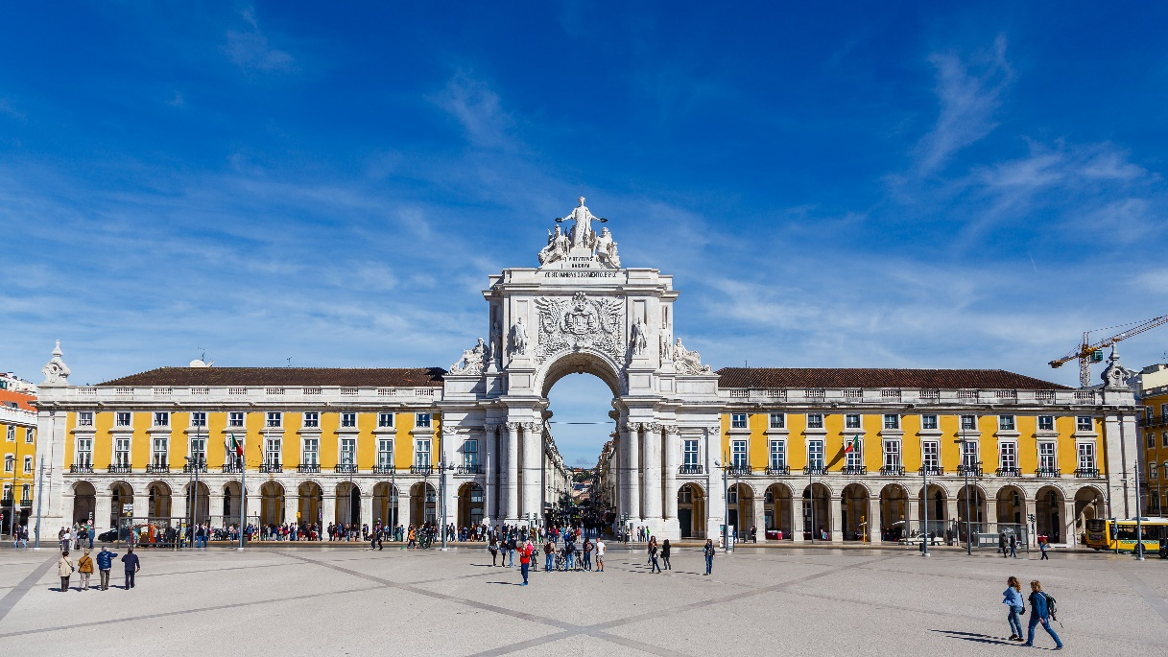
Activities
I have booked 3 activities for the couple to do throughout the holiday. There are as follows:
Take a trip to Sintra (28.1km-24 minutes from hotel) £650 for 5 days.
Go to Praça do Comércio(5km-14 minutes from hotel) £400 spending money
Visit the Garden of the Calouste Gulbenkian Foundation (1.6km- 7 minutes) £50 (£18.10 for 2 tour tickets included)
Total price= £1100

Slide 5
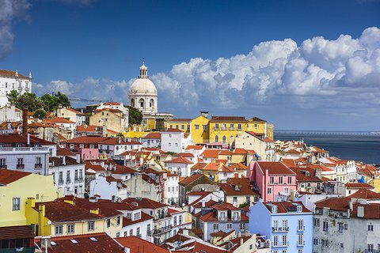
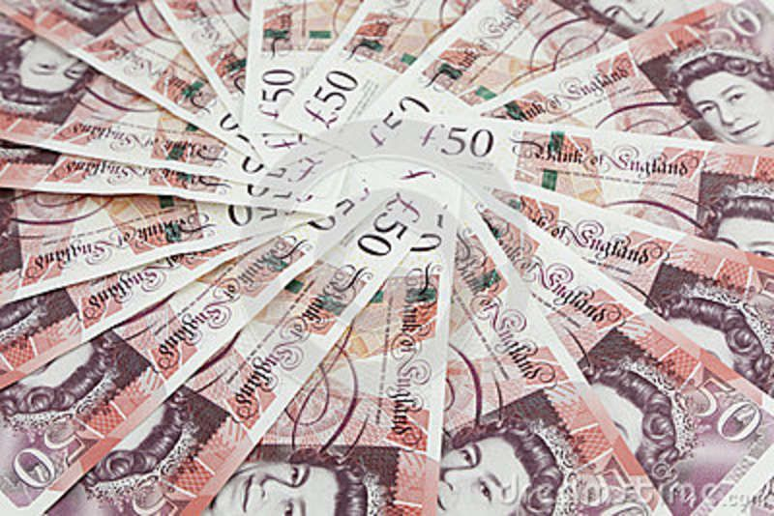
Budget
The budget I was given was £3000. I have booked an entire holiday with the total amount of money spent £2,381, saving a total of £619.
Flights= £116
Accommodation= £1165
Activities= £1100
Total= £2381

