Slide 1
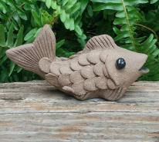
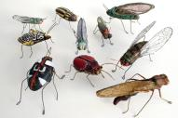
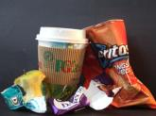
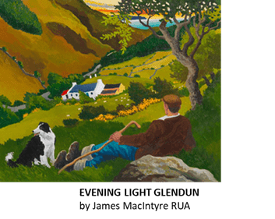
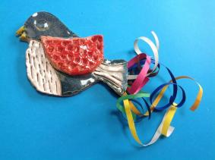
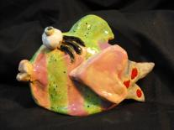
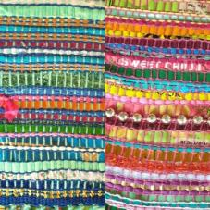
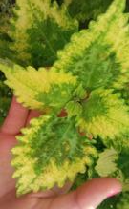
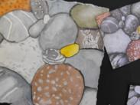
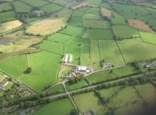
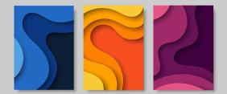
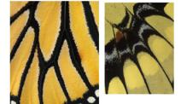
Year 8 | The Big Picture Art & Design
Theme | Caring for our Natural Environment –Protecting and valuing the fish, insects, birds and plants in our countryside. Preventing litter and pollution.
Subject matter | Shells, pebbles, litter, birds, fish, animals, insects, our coast and countryside, trees and plants.
Media | 2D -Drawing, painting, textiles(weaving), collage, printing and Photoshop 3D –Clay work + card construction
 | Focus on the Formal Visual Elements…. Line Shape Form Tone Texture Space Pattern Colour

Slide 2
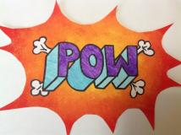
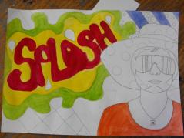
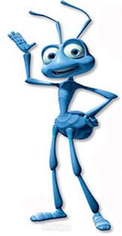
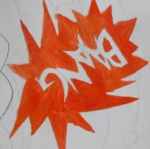
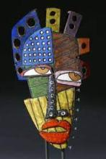
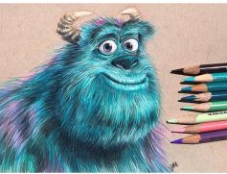
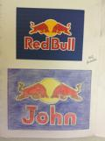
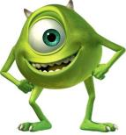
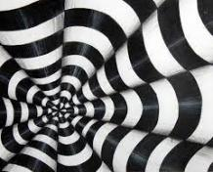
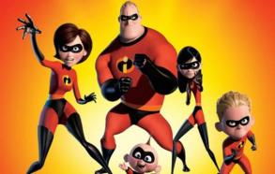
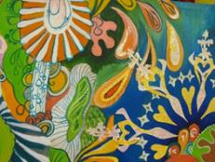
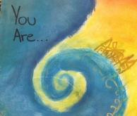
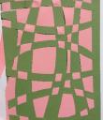
Year 9 | Art & Design -The Big Picture
Theme | Emotions and colour association. How are you feeling today? Symbolism for mood. Cartoon or animation characters have extremes of mood; super-happy, super-keen, super-sad, super-anxious, super-helpful, super-grumpy. Moody monsters!
Media | Media - 2D -Drawing, painting, textiles(stitching), collage, printing and Photoshop 3D –Clay work + card construction
Focus | Formal Visual Elements…. Line Shape Form Tone Texture Space Pattern Colour
Mood

Slide 3
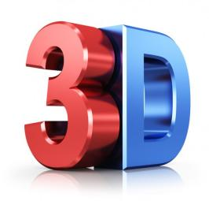
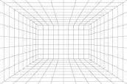
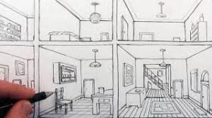
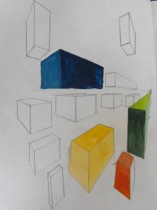
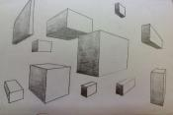
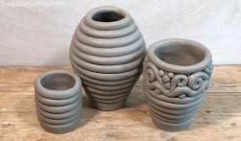
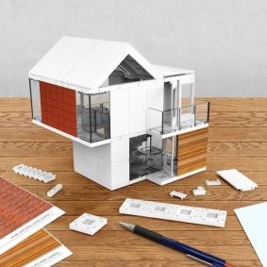
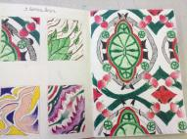
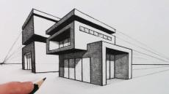
Year 10 | Art & Design The Big Picture
Theme | Year 10 –Make and create in 3D Learn how to draw in 3D, then to design and create in 3D. Rendering -Understanding 3D Perspective drawing Architecture – 3D model making Healthy buildings to live and work in: consider the environment via solar /renewable energy Clay coil pots – 3D . Form v function Photoshop – Design a logo for your building. Lino Printing / Symmetrical repeat pattern
Media | 2D -Drawing, painting, textiles, collage, printing and Photoshop 3D –Clay work + card construction
Focus on the Formal Visual Elements…. Line Shape Form Tone Texture Space Pattern Colour

